Slide 1
NYC Safety and Livability Analysis
Nigel Saurino (NS5329)
Priyank Viradia (PDV8883)
Devarsh Patel (DP3324)
05 . 08 . 23

Slide 2
Introduction
NYU brings approximately 8,000 out of state students to NYC each year.
Choosing a neighborhood to live in is difficult for any city but especially important in a place like NYC where the population is so dense and neighborhoods quickly transition in only a few streets.
With our project, we wanted to leverage publicly available data through the NYC OPEN Data program to help students identify locations with a high livability score focused on:
Safety
Rental Cost
Access to Transportation

Slide 3
Why Big Data?
It’s extremely difficult to provide a comprehensive analysis of a city that is as large as New York
The MTA subway system had a daily average ridership of 5.5 million people in 2019 (pre-pandemic) which means the data sets of recorded interactions balloon rapidly over the course of a few years.
To get a full picture of the impact of that many people in such a small geographic footprint, we anchored our analysis on the subway stations where individuals are most likely to have the most social interaction and therefore, the largest available datasets.

Slide 4
Technologies
Big Data/ML
Pyspark - To load, clean and combine data
Pyspark ML - To perform a predictive analysis that determines relative value of safety to cost for incoming students
Visualization
Geopandas - To create a geodataframe and map it onto a grid of NYC
Leafmap - To make the visualization interactive for the user with pop ups by subway station that provides additional details regarding arrests, complaints, total traffic, local rental cost

Slide 5
Challenges
Spark Instance
Executors - Had to test out various parameters like memory, maxStringToFields, cores, instances, etc.
Driver - Had to optimize data importing to allow driver to deliver data in parallel
Dataset
Partitioning - Had to partition data to equally distribute the data among the executors
Inference - Had to modify and select dataset columns to perform appropriate operations in the executors

Slide 6
Data Loading/Partitioning
Made heavy use of the NYC OPEN Data project’s API to download five key public datasets:
NYC arrests, court summons, complaints, subway stations, and turnstile activity
Downloaded a publicly available Airbnb data set as a proxy for rental costs across NYC
JSON and CSV data files are imported through spark and are repartitioned according to the executor instances during fetching

Slide 7
User Defined Functions
We made use of Pyspark’s UDF feature to implement a haversine function in order to associate incidents and NYPD reports with local subway stations that were within 0.1 miles of the alleged crime.
The UDF takes latitudes and longitudes for the subway station and the incident as arguments and returns a boolean if the incident happened in close proximity to the subway.

Slide 8
Data Preprocessing
“Filter early, filter often” - we tried to limit the size of our dataframes as soon as possible.
Cleaning - Dropped columns with invalid data
Filtering - Removed null data from dataset
Casting - Converted dataset into appropriate formats for joins and analysis
Transform - Modify and augment dependent tables to perform data joins

Slide 9
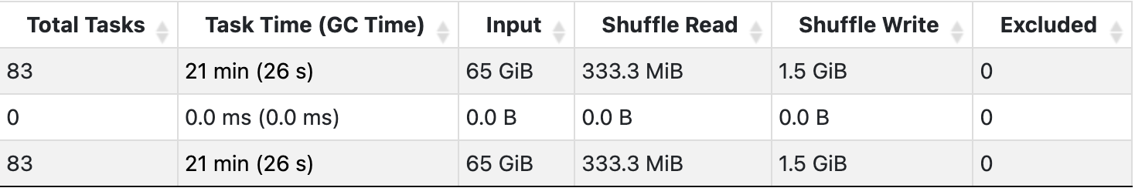
Data Consolidation
Performed sequential inner joins on 5 different datasets with a combining storage of over 50GB
Required less than 2.5GB of driver memory to perform shuffle read (333.3 MB) and write operations (1.5 GB)
Processed 65GB of data after run-time repartitioning using Spark DataFrame.

Slide 10



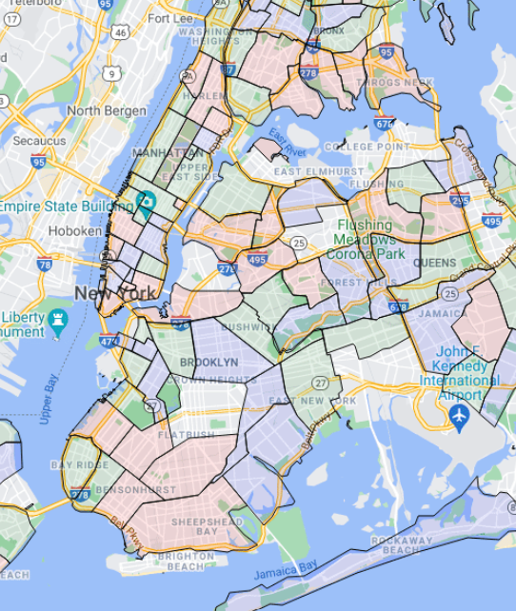


Data Pipeline
Technology and Architecture
Data Loading
Data Cleaning, Processing, Analysis
Data Visualization

Slide 11
Analysis
Interactive Mapping of NYC
Once we had bounded our dataframe size based on the number of subway stations in NYC, we made extensive use of pandas, geopandas and leafmap to build an interactive map of NYC.
We downloaded an NTA shapefile to get a backdrop map of NYC and then converted it to a coordinate reference system (crs) using geopandas so that we could map our subway dataframe directly on the crs.
Finally, we downloaded demographic data from 2020 and layered that into our map before rendering the final result using leafmap

Slide 12
ML Predictive Analysis
ML price prediction for rental rates to identify relative value in the rental market
Implemented spark pipeline:
Vector Assembler: Transformed data to create feature column
Random Forest Regressor: Created prediction model
Cross Validator: Perform dataset validation
Regression Evaluator: Evaluated test results to check error rate
Dataset: ~48k rows
Train/Test Split: 80%/20%
Features->target: lat-long -> price

Slide 13
Conclusions
Set out to build a tool to help new students answer the question - “Where should I live based on rental price, safety, access to transportation?”
Synthesized 50GB of publicly accessible data
Compared predictions from our machine learning model with current rental rates in NYC
Results:
Predict median rent near all the processed subway stations with near accuracy
Student’s can use the interactive map to explore locations and compare a suggested rental price with the value of their prospective listing in order to make an informed decision for a location that fits their budget and safety requirements.

Slide 14
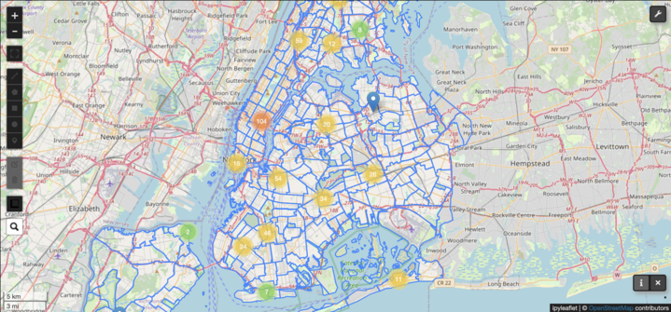
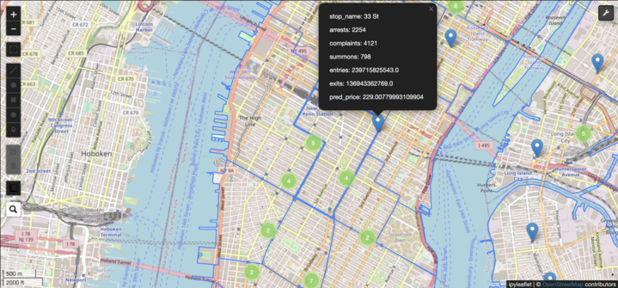
Appendix
Interactive Mapping of NYC

Slide 15
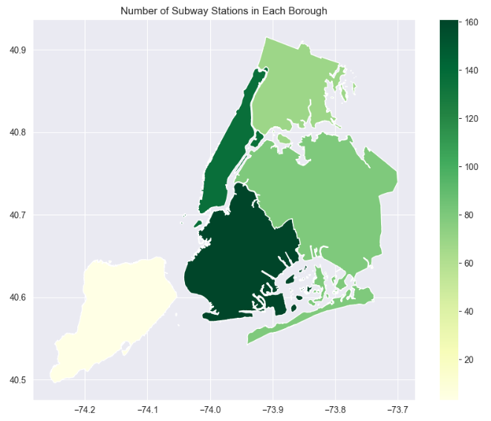
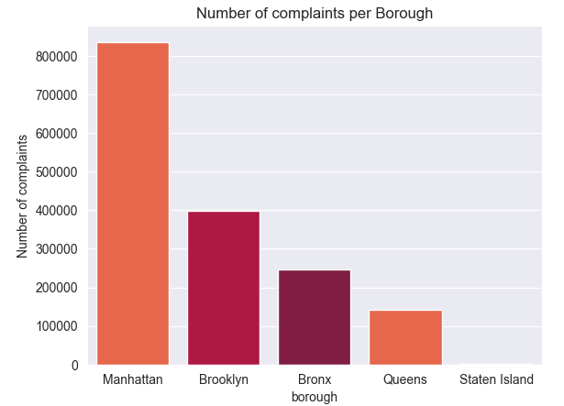
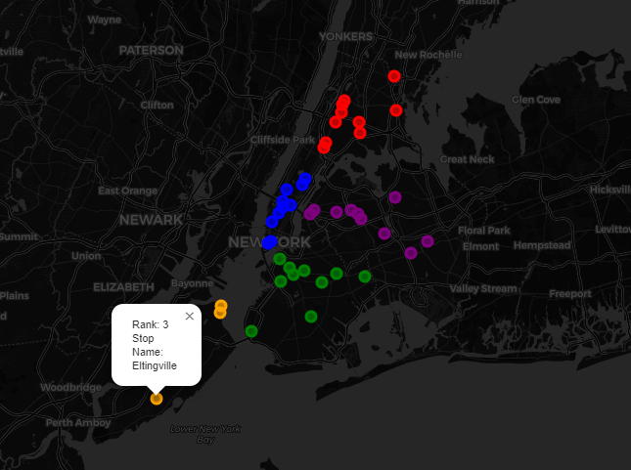
Appendix
Top Subway Stations by category, borough

Slide 16
Thank you
Priyank Viradia
Devarsh Patel
Nigel Saurino

